Slide 1

TDT 4200 Fall 2024 Parallel Computing CUDA Intro lect 2-3 (based on CalTech Lect 2-4 – spring 2024)
Prof. Anne C. Elster, PhD
Dept. of Computer Science (IDI)
Norwegian Univ. of Science & Technology
(NTNU Trondheim, Norway)
&
Univ. of Texas at Austin (Senior Visiting Scientist)
Anne C. Elster NTNU
TDT4200 2024

Slide 2
TDT4200 Fall 2024 Student Reference Group
Please contact for praise and suggestions on how we
can make this course better:
Ingar Asheim – ingara@stud.ntnu.no
Elin Skålund Berntsen – elinsbe@stud.ntnu.no
Hanne Marie Haakaas – hannamhaa@stud.ntnu.no
Suzanne Maduga – suzannm@stud.ntnu.no
Simone Deidier – simondei@stud.ntnu.no
Davide Esposito – davidees@stud.ntnu.no
Diego Velasco – diegove@stud.ntnu.no
???
???
+ Need someone that are from NTNU, but not CS….
Anne C. Elster – 2024

Slide 3
TDT4200 F2024 Course Information – See also https://www.ntnu.edu/studies/courses/TDT4200/
PS 5 on CUDA intro out this morning, due Oct 21
Will accept until Oct 28, but then cannot be late on PS6!
NOTE: Compulsory assignments:
You need to do and pass ALL Problem Sets/Exercises in order to take the final
… also those that are Pass/Fail!!

Slide 4
Outline
CUDA Intro
– review of multiplication example
-- CUDA memory system
Based on
-- CalTech Slides: http://courses.cms.caltech.edu/cs179/
(taught Spring 2024)
Elster CUDA draft
Kirk CUDA Book
Anne C. Elster – 2024

Slide 5
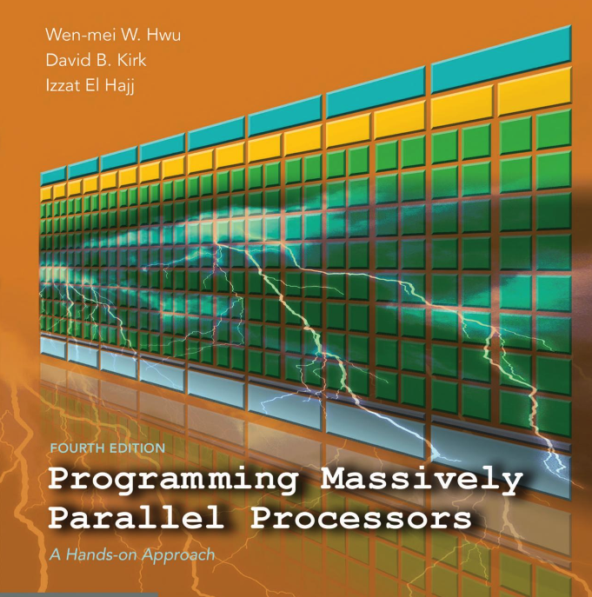
CUDA Book by Hwu, Kirk & Haji, 4th edition (2022): Chapters 1-8 preview online!

Slide 6
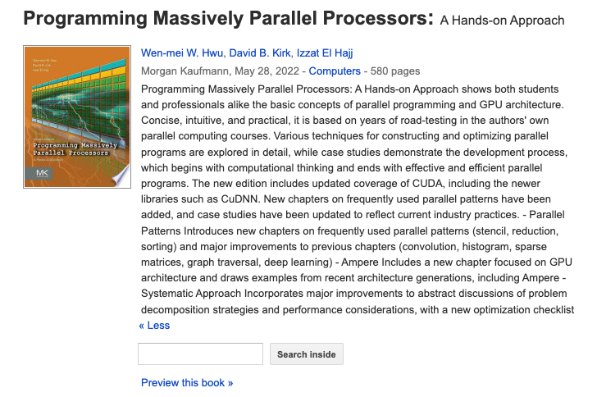
CUDA Book 4th Edition (2022): Chapters 1-8 preview online!

Slide 7
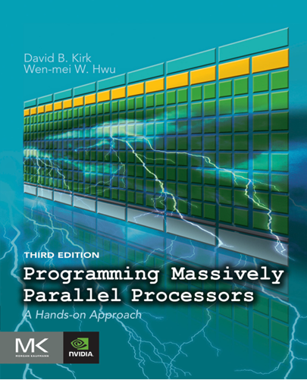
CUDA Book by Kirk 3rd edition (v2017) – available online http://gpu.di.unimi.it/books/PMPP-3rd-Edition.pdf!

Slide 8
CUDA Book by Elster & Khan v2014-draft: May update – provided on BlackBoard later this week
Includes PS 5 solution. ☺
Note Old (3rd editon and older) of Kirk book is available on-line as PDF

Slide 9
GPU Programming
CUDA (targets Nvidia GPUs) – this course
OpenCL – more verbose, but works on AMD GPUs etc.
works also on other heterogenouse platforms
HIP (CUDA envelope for OpenCL on AMD (e.g. LUMI)
…
Some of these can also be combined with MPI,
E.g.
MPI + Pthreads or MPI + Pthread
MPI + CUDA (across many GPU systems)

Slide 10
CUDA program – step by step – very similar to PS4!!
1) Setup inputs on the host (CPU-accessible memory)
- Allocate memory for outputs on the host CPU
- Create the kernal that performs the calculations
2) Set up device (GPU) memory
incl. Copy inputs from host to GPU (slow)
3) Execute kernal on device (GPU) - fast!
4) Transfer result from device (GPU) to host (slow)
5) Free the device memory
NOTE: Copying can be asynchronous,
and unified memory management is available

Slide 11
Slides based on CalTech CS 179: GPU Computing
Lecture 2: Intro to the simd lifestyle and GPU internals
Notes:
Resume – remarks:
Welcome back
Storytelling/motivational purposes
Introducing

Slide 12
Last time we discussed:
Can use GPU to solve highly parallelizable problems
Looked at the a[] + b[] -> c[] example
CUDA is a straightforward extension to C / C++
Separate CUDA code into .cu and .cuh files
Compile with nvcc, NVIDIA’s compiler for CUDA, to create object files (.o files)
Search for “Resource” links on http://courses.cms.caltech.edu/cs179/

Slide 13
A Few GPU Keywords to Remember…
CUDA – Nvidia’s C++ like language for programming GPUs
(Originally Compute Unified Device Architecture)
nvcc – nVidia CUDA compiler
SM -- Streaming Multiprocessor
https://en.wikipedia.org/wiki/Stream_processing
SIMD computation – Single instruction, multiple data (SIMD) is a class of parallel computers in Flynn's taxonomy.
https://en.wikipedia.org/wiki/SIMD
SIMT computation – Single instruction, multiple threads
https://en.wikipedia.org/wiki/Single_instruction,_multiple_threads

Slide 14
More GPU Keywords …
Threads of execution are the smallest sequence of programmed instructions that can be managed independently by a scheduler, which is typically a part of the operating system
https://en.wikipedia.org/wiki/Thread_(computing)
Thread block is a programming abstraction that represents a group of threads that can be executed serially or in parallel.
https://en.wikipedia.org/wiki/Thread_block_(CUDA_programming)
Nvidia GRID is a family of graphics processing units (GPUs)
https://en.wikipedia.org/wiki/Nvidia_GRID
Warps -- On the hardware side, a thread block is composed of ‘warps’. A warp is a set of 32 threads within a thread block such that all the threads in a warp execute the same instruction. These threads are selected serially by the SM
https://en.wikipedia.org/wiki/Thread_block_(CUDA_programming)#Warps
Warp Divergence – All threads must generally execute the same code (if-then-else).
https://cvw.cac.cornell.edu/gpu/thread_div

Slide 15
NVCC and gcc / G++
CUDA is simply an extension of other bits of code you write!!!!
Evident in .cu/.cuh vs .cpp/.hpp distinction
.cu/.cuh is compiled by nvcc to produce a .o file
Since CUDA 7.0 / 9.0 there’s support by NVCC for most C++11 / C++14 language features, but make sure to read restrictions for device code
https://docs.nvidia.com/cuda/cuda-c-programming-guide/index.html#c-cplusplus-language-support
.cpp/.hpp is compiled by g++ and the .o file from the CUDA code is simply linked in using a "#include xxx.cuh" call
No different from how you link in .o files from normal C++ code

Slide 16
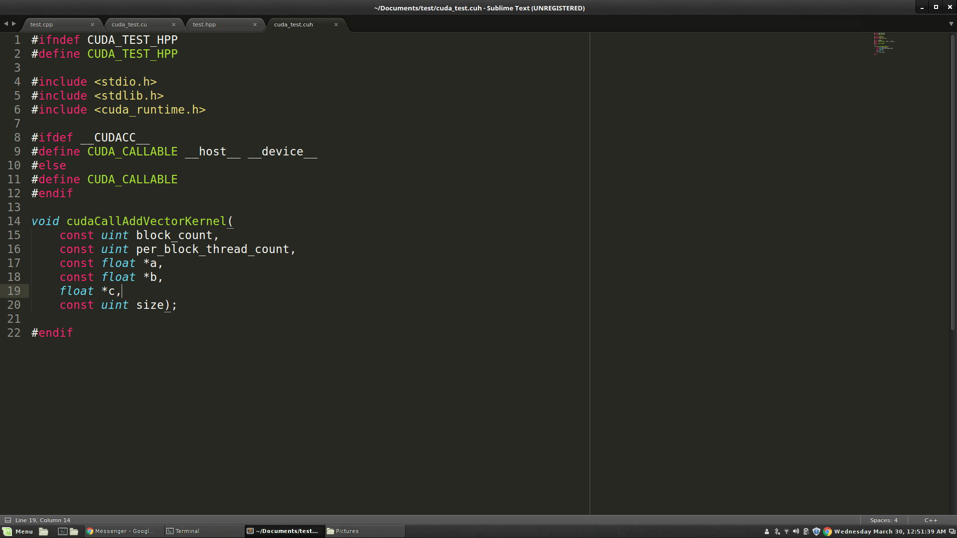
.cu/.cuh vs .cpp/.hpp

Slide 17
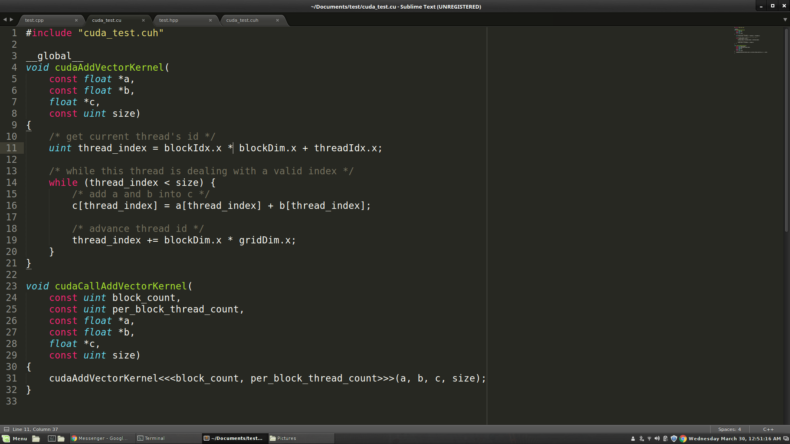
.cu/.cuh vs .cpp/.hpp

Slide 18
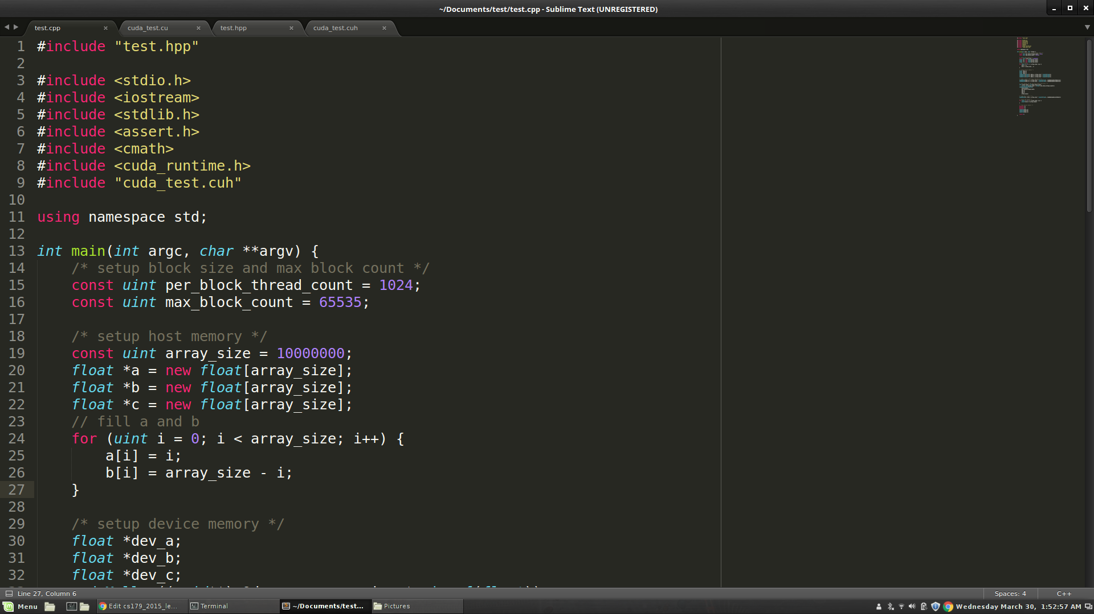
.cu/.cuh vs .cpp/.hpp

Slide 19
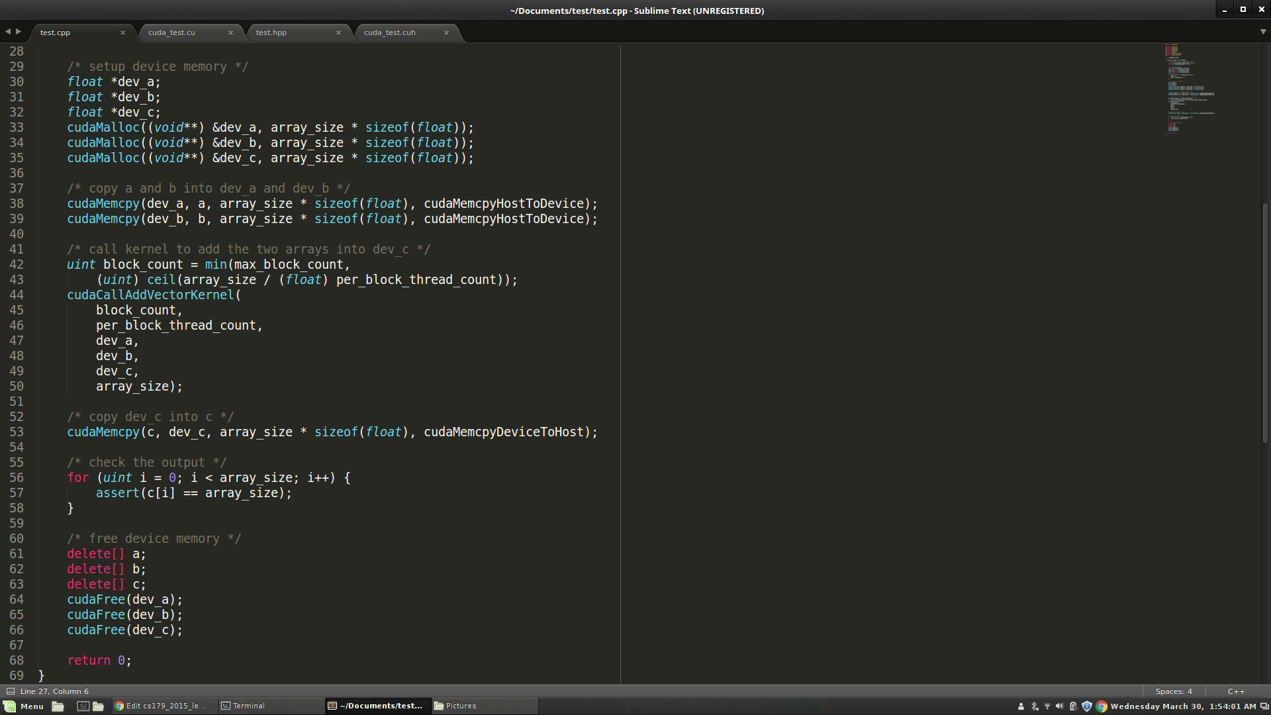
.cu/.cuh vs .cpp/.hpp

Slide 20
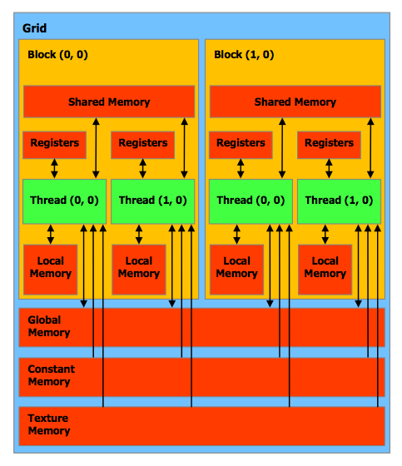
CUDA Memory Organization
Keywords you MUST know to code in CUDA:
Thread - Distributed by the CUDA runtime (threadIdx)
Block - A user defined group of 1 to ~512 threads (blockIdx)
Grid - A group of one or more blocks. A grid is created for each CUDA kernel function called.
Imagine thread organization as an array of thread indices
Notes:
Point out how the different architectures have different thread per block counts.

Slide 21
Block and Grid Dimensions
For many parallelizeable problems involving arrays, it’s useful to think of multidimensional arrays.
E.g. linear algebra, physical modelling, etc, where we want to assign unique thread indices over a multidimensional object
So, CUDA provides built in multidimensional thread indexing capabilities with a struct called dim3!

Slide 22
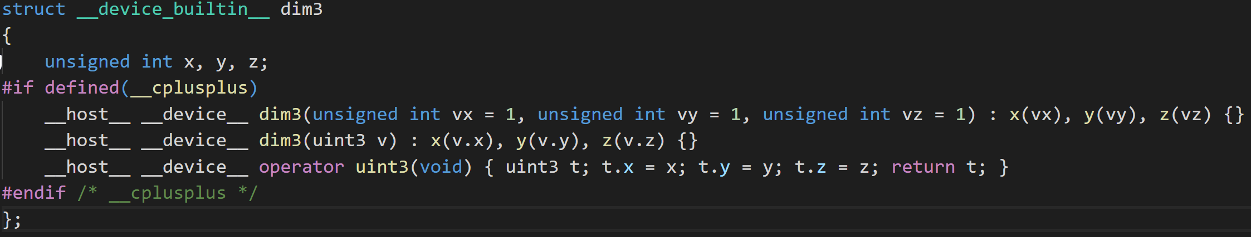
Dim3
dim3 is a struct (defined in vector_types.h) to define your Grid and Block dimensions.
Works for dimensions 1, 2, and 3:
dim3 grid(256); // defines a grid of 256 x 1 x 1 blocks
dim3 block(512, 512); // defines a block of 512 x 512 x 1 threads
foo<<<grid, block>>>(...);

Slide 23
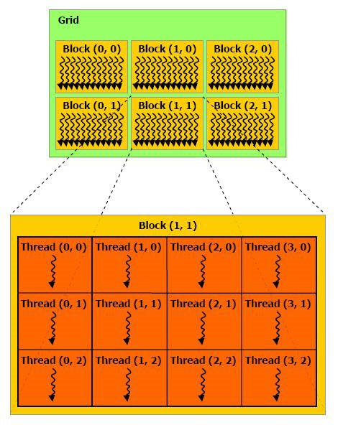
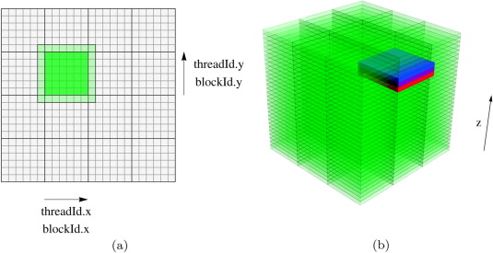
Grid/Block/Thread Visualized

Slide 24
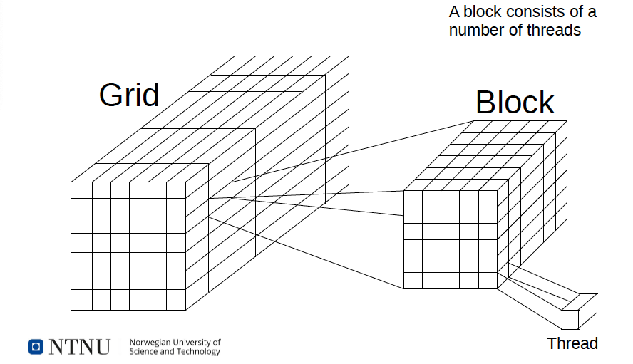
CUDA Kernel – indexing Thread Hierarchy (based on Bart VB slides)

Slide 25
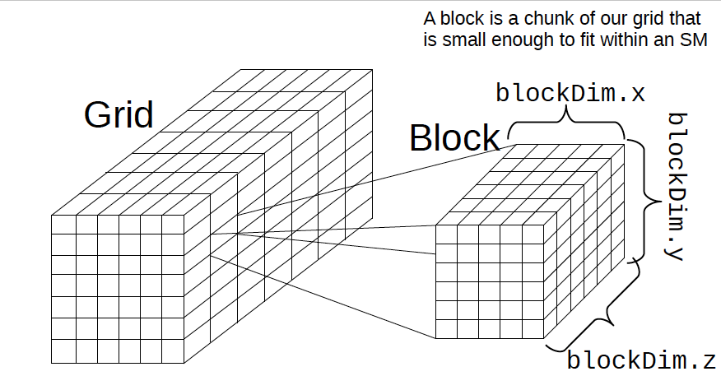
CUDA Kernel – indexing Thread Hierarchy (based on Bart VB slides)

Slide 26
Single Instruction, Multiple Data (SIMD)
SIMD describes a class of instructions which perform the same operation on multiple registers simultaneously.
Example: Add some scalar to 3 registers, storing the output for each addition in those registers.
Used to increase the brightness of a pixel
CPUs also have SIMD instructions and are very important for applications that need to do a lot of number crunching
Video codecs like x264/x265 make extensive use of SIMD instructions to speed up video encoding and decoding.

Slide 27
SIMD continued
Converting an algorithm to use SIMD is usually called “Vectorizing”
Not every algorithm can benefit from this or even be vectorized at all, e.x. Parsing.
Using SIMD instructions is not always beneficial though.
Even using the SIMD hardware requires additional power, and thus waste heat.
If the gains are small it probably isn’t worth the additional complexity.
Optimizing compilers like GCC and LLVM are still being trained to be able to vectorize code usefully, though there has been many exciting developments on this front in the last 2 years and is an active area of study.
https://polly.llvm.org/

Slide 28
SIMT (Single Instruction, Multiple Thread) Architecture
A looser extension of SIMD which is what CUDA’s computational model uses
Key differences:
Single instruction, multiple register sets
Wastes some registers, but mostly necessary for following two points
Single instruction, multiple addresses (i.e. parallel memory access!)
Memory access conflicts! Will discuss next week.
Single instruction, multiple flow paths (i.e. if statements are allowed!!!)
Introduces slowdowns, called ‘warp-divergence.’
Good description of differences
https://yosefk.com/blog/simd-simt-smt-parallelism-in-nvidia-gpus.html
https://docs.nvidia.com/cuda/cuda-c-programming-guide/index.html#hardware-implementation

Slide 29

Thread blocks and Warps – Questions?
Copyright Games Workshop inc.

Slide 30
Important CUDA Hardware Keywords!
Streaming Multiprocessor (SM) – Each contains (usually) 128 single precision CUDA cores (which execute a thread) and their associated cache.
This is a standard based on your machines (GPUs´s) Compute Capability.
Warp – A unit of up to 32 threads (all within the same block)
Each SM creates and manages multiple warps via the block abstraction. Assigns to each warp a Warp Scheduler to schedule the execution of instructions in each warp.
Warp Divergence – A condition where threads within a warp need to execute different instructions in order to continue executing their kernel.
In order to maintain multiple flow path per instruction, threads in different ‘execution branches’ during an instruction are given no-ops.
Causes threads to execute sequentially, in most cases ruining parallel performance.
As of the Kepler (2012) architecture each Warp can have at most 2 branches, starting with Volta (2017) this condition has been nearly eliminated. For this class assume your code must only branch at most twice as we are not yet allocating Volta GPUs to this class.
Inpendent Thread Scheduling fixes this problem by maintianing an execution state per thread. See Compute Capability 7.x

Slide 31
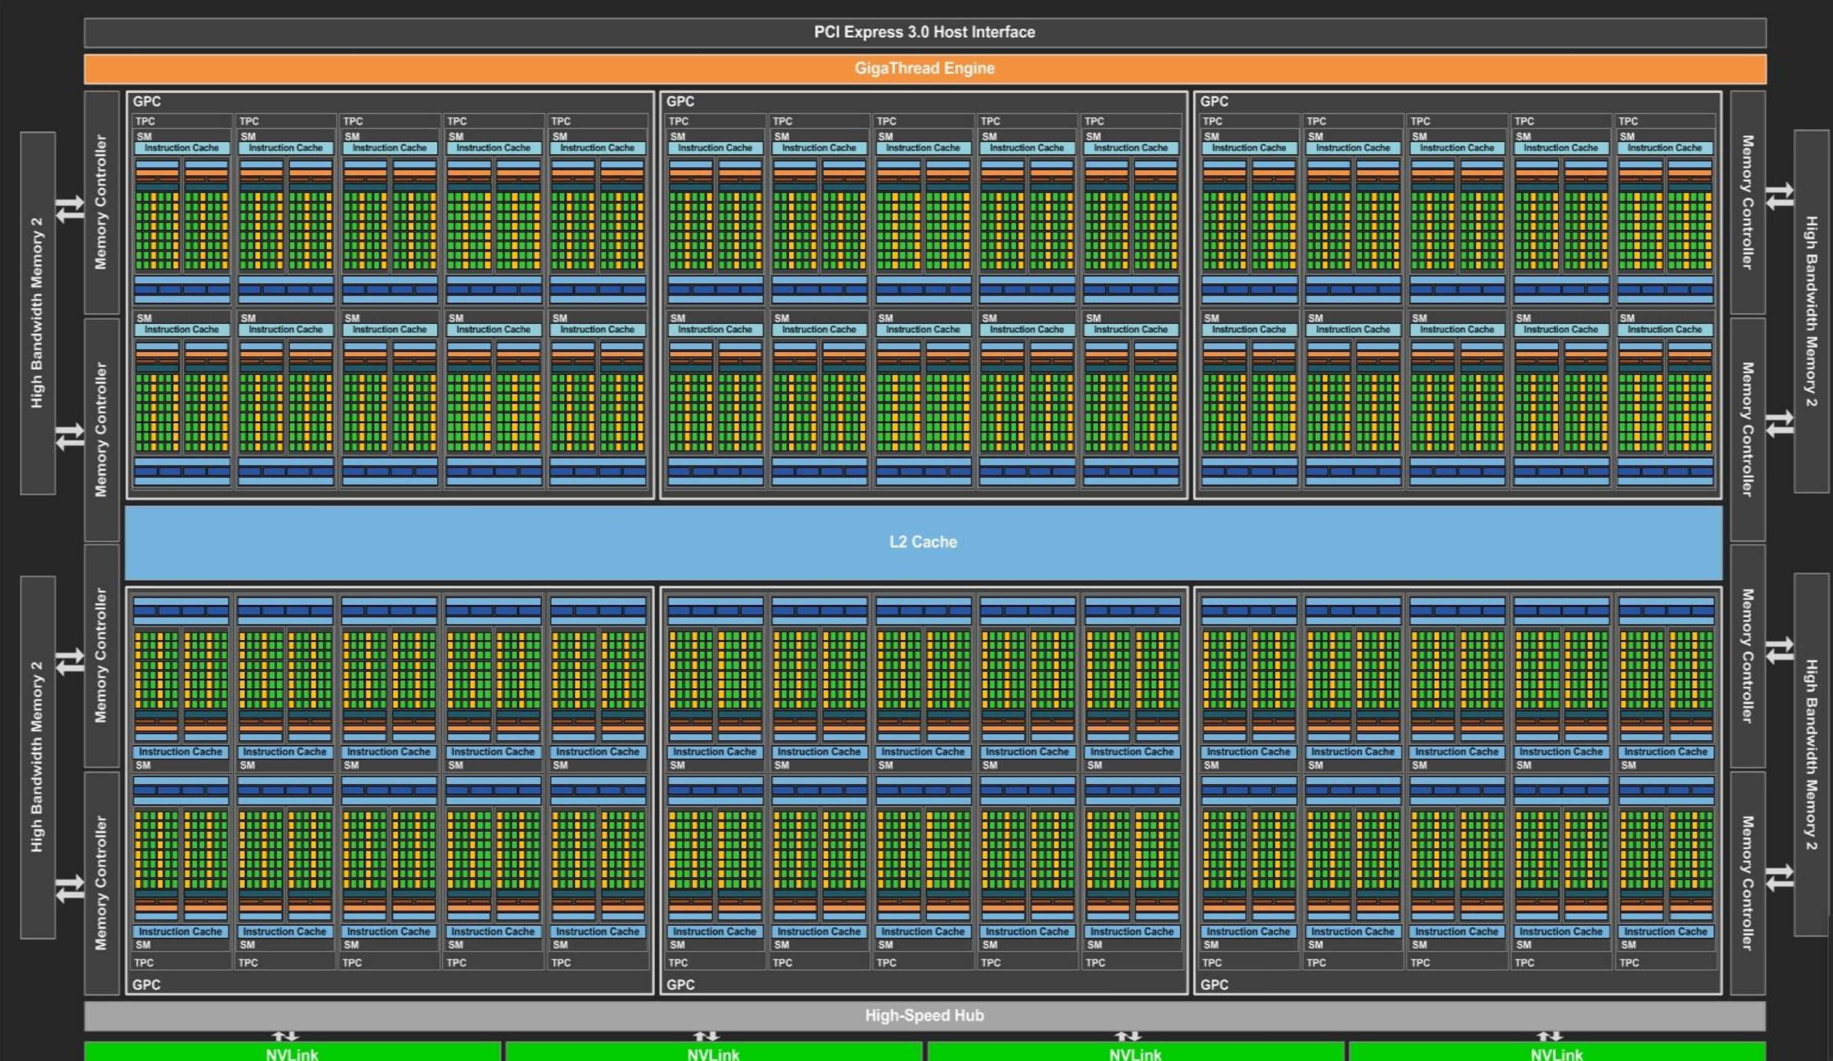
What a modern GPU looks like

Slide 32
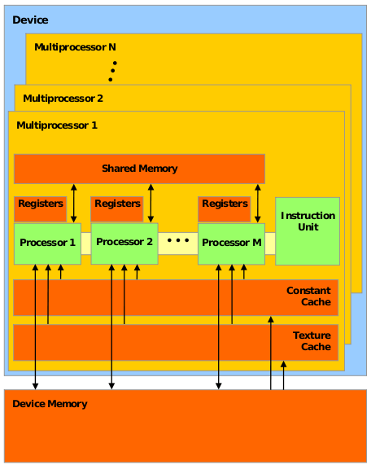
Inside a GPU
The black Xs are just crossing out things you don’t have to think about just yet.
We’ll cover memory next class

Slide 33
Inside a GPU
Think of Device Memory (we will also refer to it as Global Memory) as a RAM for your GPU
Faster than getting memory from the actual RAM but still have other options
Will come back to this in future lectures
GPUs have many Streaming Multiprocessors (SMs)
Each SM has multiple processors but only one instruction unit (each thread shares program counter)
Groups of processors must run the exact same set of instructions at any given time within a single SM

Slide 34
Inside a GPU
When a kernel (the <<<<. .>>> you define in .cu files) is called, the task is divided up into threads
Each thread handles a small portion of the given task
The threads are divided into a Grid of Blocks
Both Grids and Blocks are 3 dimensional
e.g.
dim3 dimBlock(8, 8, 8);
dim3 dimGrid(100, 100, 1);
Kernel<<<dimGrid, dimBlock>>>(…);
However, we'll often only work with 1 dimensional grids and blocks
e.g. Kernel<<<block_count, block_size>>>(…);

Slide 35
Inside a GPU
Maximum number of threads per block count is usually 512 or 1024 depending on the machine
Maximum number of blocks per grid is usually 65535
If you go over either of these numbers your GPU will just give up or output garbage data
Much of GPU programming is dealing with this kind of hardware limitations! Get used to it
This limitation also means that your Kernel must compensate for the fact that you may not have enough threads to individually allocate to your data points
Will show how to do this later (this lecture)

Slide 36
Inside a GPU
Each block is assigned to an SM
Inside the SM, the block is divided into Warps of threads
Warps consist of 32 threads
CUDA defined constant in cuda_runtime.h
All 32 threads MUST run the exact same set of instructions at the same time
Due to the fact that there is only one instruction unit
Warps are run concurrently in an SM
If your Kernel tries to have threads do different things in a single warp (using if statements for example), the two tasks will be run sequentially
Called Warp Divergence (NOT GOOD)

Slide 37
Inside a GPU (fun hardware info)
In Fermi Architecture (i.e. GPUs with Compute Capability 2.x), each SM has 32 cores, later architectures have more.
e.g. GTX 400, 500 series
32 cores is not what makes each warp have 32 threads. Previous architecture also had 32 threads per warp but had less than 32 cores per SM
Some early Pascal (2016) GPUs (GP100) had 64 cores per SM, but later chips in that generation (GP104) had 128 core model.
Turing (2018) maintains 128 core standard
Our Snotra server have 20 T4 GPUs each

Slide 38
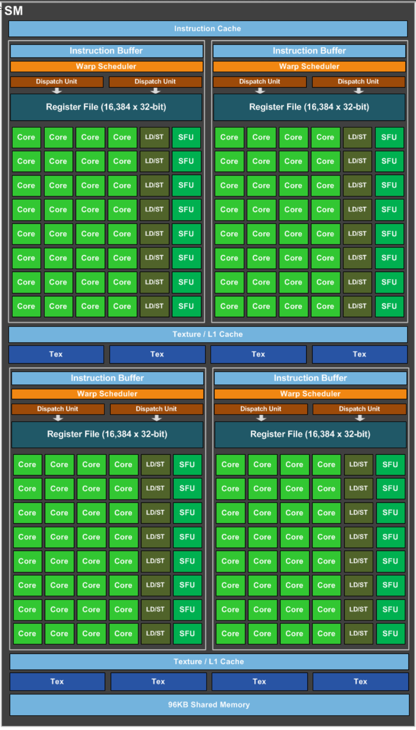
Streaming Multiprocessor
Shown here is a Pascal GP104 GPU Streaming Multiprocessor that can be found in a GTX1080 graphics card.
The exact amount of Cache and Shared Memory differ between GPU models, and even more so between different architectures.
Whitepapers with exact information can be gotten from Nvidia (use Google)
https://international.download.nvidia.com/geforce-com/international/pdfs/GeForce_GTX_1080_Whitepaper_FINAL.pdf
http://www.nvidia.com/content/PDF/product-specifications/GeForce_GTX_680_Whitepaper_FINAL.pdf
“nvidia kepler whitepaper”

Slide 39
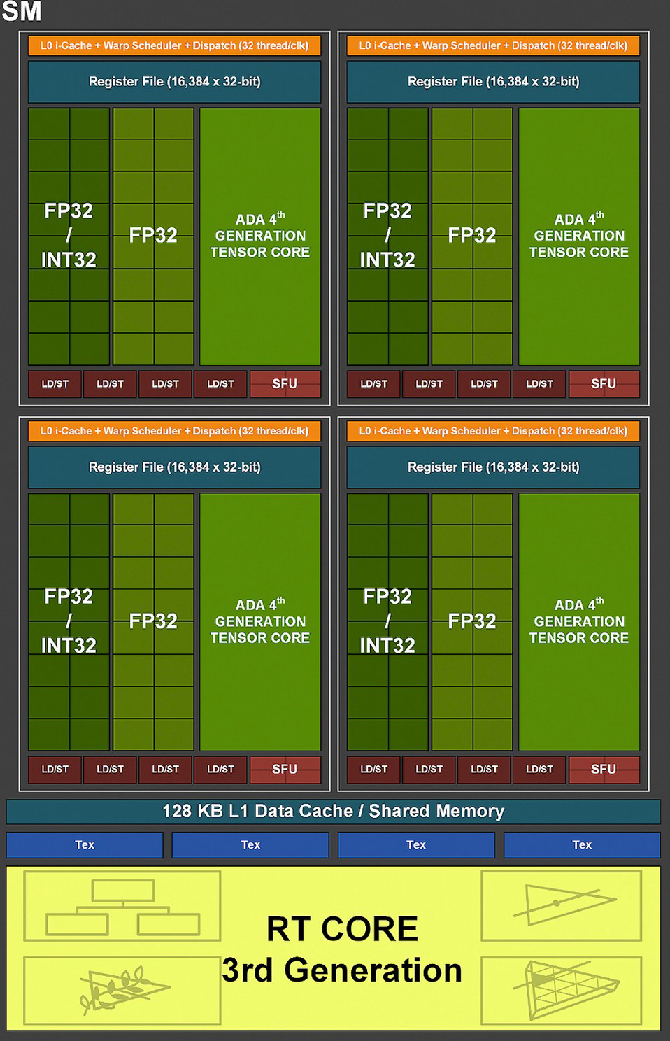




CUDA Kernel – indexing Thread Hierarchy (based on Bart VB slides)
An SM can only have a certain number of threads active at the same time (usually 2048)
Our problems are usually much larger, and we tend to use many threads
→ Solution: thread hierarchy

Slide 40
A[] + B[] -> C[] (again)

Slide 41
A[] + B[] -> C[] (again)

Slide 42
A[] + B[] -> C[] (new!!)

Slide 43

Questions for hardware?

Slide 44
Stuff that will be useful later for C++ coders

Slide 45
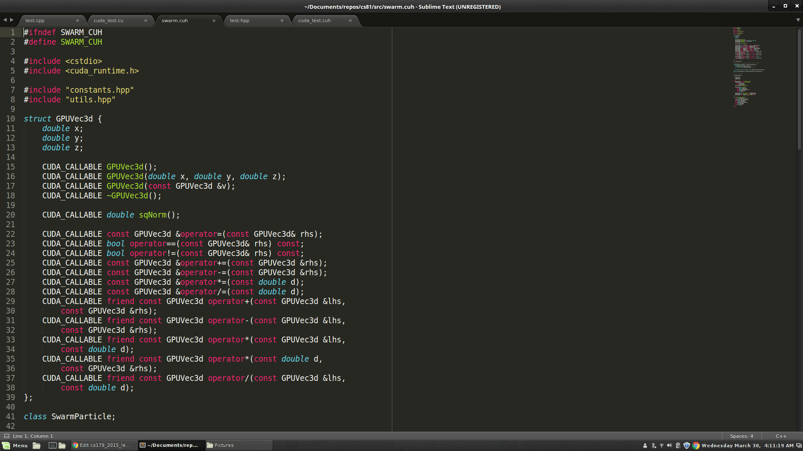
Stuff that will be useful later

Slide 46


Stuff that will be useful later

Slide 47
Next Class...
Global Memory access is not that fast
Tends to be the bottleneck in many GPU programs
Especially true if done stupidly
We'll look at what "stupidly" means
Optimize memory access by utilizing hardware specific memory access patterns
Optimize memory access by utilizing different caches that come with the GPU

Slide 48
From CalTech CS 179: GPU Programming
Lecture 4: GPU Memory Systems

Slide 49
Last time
Thread block organization: a grid of blocks of threads
Streaming multiprocessor (SM): CUDA cores and cache
A block is assigned to and executed on a single SM
Warp: A group of up to 32 threads within a block
Threads in a single warp can only run 1 set of instructions at once
Performing different tasks can cause warp divergence and affect performance

Slide 50
OUTLINE
Latency and Throughput
GPU Memory Systems

Slide 51
Some Key Terms re. memory:
Cache -- https://en.wikipedia.org/wiki/Cache_(computing)
Types of Memory – Local, Global, Cache, Shared, etc.
https://en.wikipedia.org/wiki/Computer_memory
Registers -- https://en.wikipedia.org/wiki/Processor_register
Bank conflicts and strides …
Memory Coalescing and Transactions …
Padding …
Will add old book chapter by Elster on BlackBoard

Slide 52
Latency & Throughput, Properties
Latency is the delay caused by the physical speed of the hardware
Throughput is the maximum rate of production/processing
CPU = low latency, low throughput
CPU clock = 3 GHz (3 clocks/ns)
CPU main memory latency: ~100+ ns
CPU arithmetic instruction latency: ~1+ ns
GPU = high latency, high throughput
GPU clock = 1 GHz (1 clock/ns)
GPU main memory latency: ~300+ ns
GPU arithmetic instruction latency: ~10+ ns
Above numbers were for Kepler GPUs (e.g. GTX 700 series)
For Fermi, latencies tend to be double that of Kepler GPUs
Notes:
Clock rate – frequency at which the chip Is running (processor’s speed)

Slide 53
Compute & IO Throughput
GeForce GTX Titan Black (GK110 based)
Compute throughput | 5 TFLOPS (single precision)
Global memory bandwidth | 336 GB/s (84 Gfloat/s)
GPU is very IO limited! IO is very often the throughput bottleneck, so its important to be smart about IO.
If you want to get beyond ~900 GFLOPS, need to do multiple FLOPs per shared memory load.
Notes:
TFLOP = Teraflop; a way of measuring the power of a computer based on mathematical capability. (Capability of a processor to calculate one trillion floating-point operations per second)
Memory bandwidth = rate at which data can be read from or stored into a semiconductor memory by a processor
Due to design of GPU, IO (memory access) and compute happen at the same time. IO is generally the bottleneck.
Based on these numbers, will GPUs perform better on algorithms will high computational density or low computational density?
This is why bank conflicts matter.
80% utilization on GPU is great. We’re up to around 93% utilization for single threaded CPU matrix multiplication (probably the most tuned optimized code).

Slide 54
Cache
A cache is a chunk of memory that sits in between a larger pool of memory and the processor
Often times implemented at hardware level
Has much faster access speed than the larger pool of memory
When memory is requested, extra memory near the requested memory is read into a cache
Amount read is cache and memory pool specific
Regions of memory that will always be cached together are called cache lines
This makes future accesses likely to be found in the cache
Such accesses are called cache hits and allow much faster access
If an access is not found in the cache, it's called a cache miss (and there is obviously no performance gain)

Slide 55
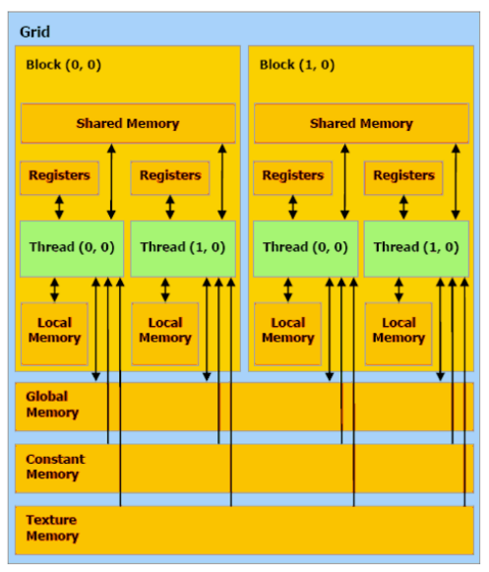
GPU Memory Breakdown
Registers
Local memory
Global memory
Shared memory
L1/L2/L3 cache
Constant memory
Texture memory
Read-only cache (CC 3.5+)
Notes:
Global memory: Slow and uncached, all threads
Texture memory (read only): Cache optimized for 2D access, all threads
Constant memory (read only): Slow, cached, all threads
Shared memory: Fast, bank conflicts; limited; threads in block
Registers: Fast, only for one thread
Local memory: For what doesn’t fit in registers, slow but cached, one thread

Slide 56
Part 1: Regs, Local, Share & Global Memory
Registers: The fastest form of memory on the multi-processor. Is only accessible by the thread. Has the lifetime of the thread.
Local memory: Resides in global memory and can be 150x slower than register or shared memory. Is only accessible by the thread. Has the lifetime of the thread.
Shared Memory: Can be as fast as a register when there are no bank conflicts or when reading from the same address. Accessible by any thread of the block from which it was created. Has the lifetime of the block.
Global memory: Potentially 150x slower than register or shared memory -- watch out for uncoalesced reads and writes. Accessible from either the host or device. Has the lifetime of the application—that is, it persistent between kernel launches.

Slide 57
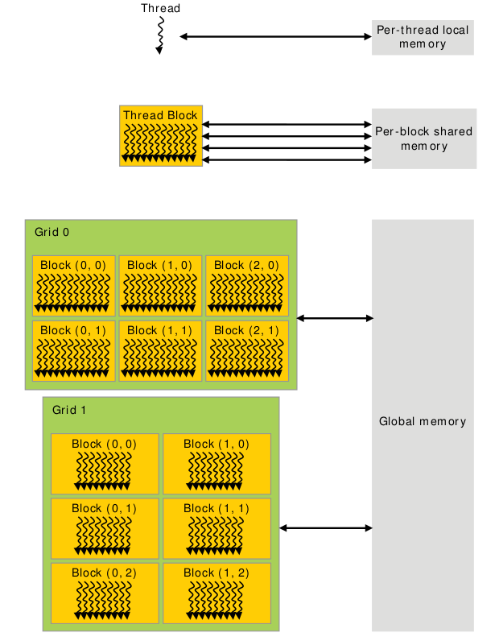
Memory Scope
Notes:
When talking about different memory types, we need to talk about both the scope as well as the hardware implementation.
The scope is simply who can access the memory and what is the lifetime of the memory.
Notably, the hardware implementation can limit the scope (as is the case for local memory), but the scope is often limited beyond what the hardware does.

Slide 58
Global Memory
Global memory is separate hardware from the GPU core (containing SM’s, caches, etc).
The vast majority of memory on a GPU is global memory
If data doesn’t fit into global memory, you are going to have process it in chunks that do fit in global memory.
GPUs have .5 - 24GB of global memory, with most now having ~2GB.
Global memory latency is ~300ns on Kepler and ~600ns on Fermi

Slide 59
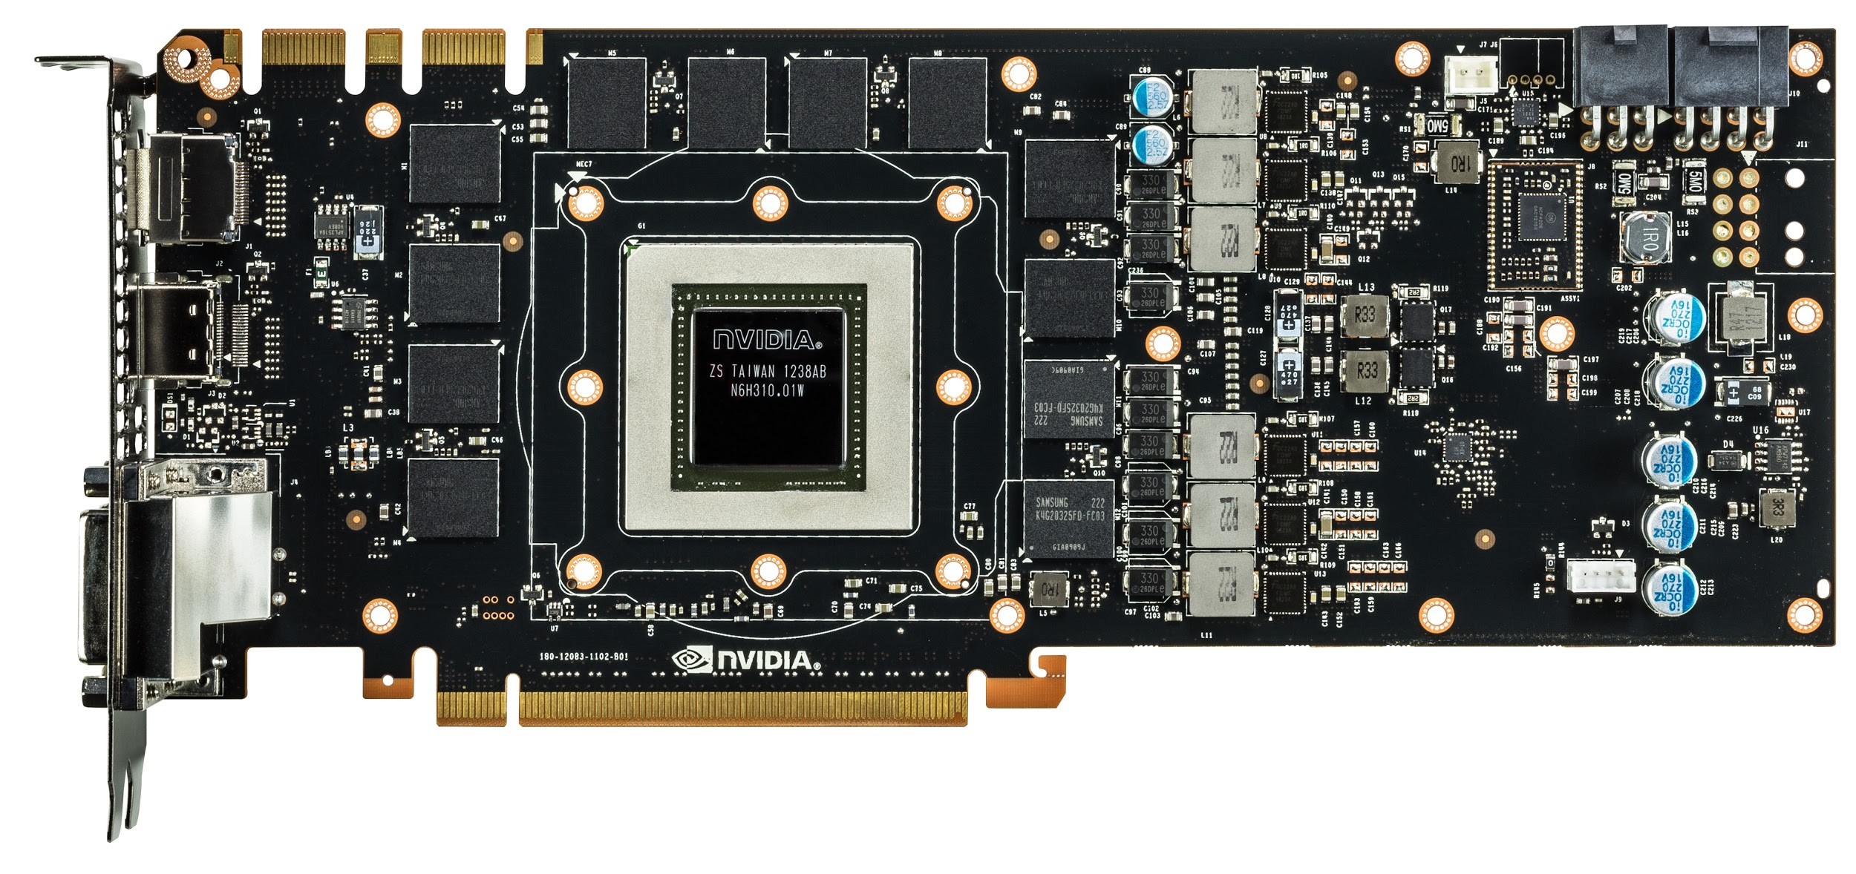
Green box is GK110, red lines are global memory
Nvidia GeForce GTX 780
Notes:
Everything we’ve been talking about is the GPU core. These are made by Nvidia and are the “interesting” part of the GPU.
The global memory is not part of the GPU core, and is in this case manufactured by Samsung. Its RAM similar to what is already in your computer.
Note that not being located on the same silicon generally hurts performance. This is true for accessing global memory from the GPU, and is also (very) true for moving data to GPU over PCI-E.
Light travels about 1 foot each ns (in vacuum).

Slide 60
Accessing global memory efficiently
Global memory IO is the slowest form of IO on GPU
except for accessing host memory (duh...)
Because of this, we want to access global memory as little as possible
Access patterns that play nicely with GPU hardware are called coalesced memory accesses.

Slide 61
Memory Coalescing
Memory accesses are done in large groups setup as
Memory Transactions
Done per warp
Fully utilizes the way IO is setup at the hardware level
Coalesced memory accesses minimize the number of cache lines read in through these memory transactions
GPU cache lines are 128 bytes and are aligned
Memory coalescing is much more complicated in reality
Will cover some examples later, but fairly simple strategies used in this class.
Notes:
Explain what a cache line is from perspective of CPU.
On CPU, 1 load only touches 1 cache line. On GPU, not the case.
Follow with several slides of pictures.

Slide 62
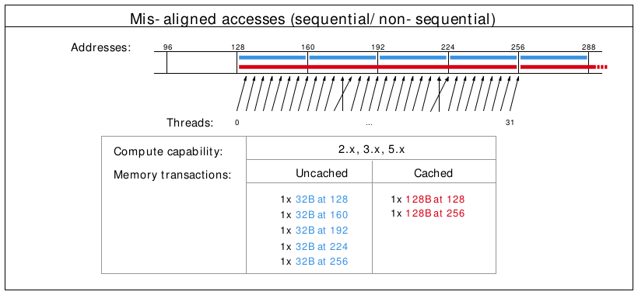
Misalignment can cause non-coalesced access
Notes:
The cross lines don’t matter, but the misalignment causes 2 loads to be done (because first loaded address is 130 rather than 120)

Slide 63
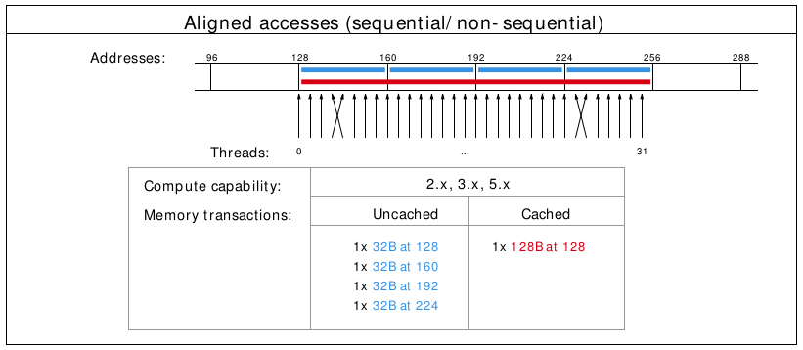
A coalesced access!
Notes:
The cross lines don’t matter, just the total number of cache lines touched.

Slide 64
Shared Memory
Very fast memory located in the SM
Same hardware as L1 cache (will discuss later)
~5ns of latency
Maximum size of ~48KB (varies per GPU)
Scope of shared memory is the block
Remember: SM = streaming multiprocessor
SM ≠ shared memory
Notes:
Nvidia says shared memory latency is “roughly 100x lower”, so probably closer to 3ns, but 5ns is closer enough and easier to think about.
Why is scope of shared memory not global?

Slide 65
Shared memory syntax
Can allocate shared memory statically (size known at compile time) or dynamically (size not known until runtime)
Static allocation syntax:
__shared__ float data[1024];
Declared in the kernel, nothing in host code
Dynamic allocation syntax
Host:
kernel<<<grid_dim, block_dim, numBytesShMem>>>(args);
Device (in kernel):
extern __shared__ float s[];
For multiple dynamically sized variables, see this blog post
Little bit more complicated and there are easy alternatives

Slide 66
A shared memory application
Task: Compute byte frequency counts
Input: array of bytes of length n
Output: 256 element array of integers containing number of
occurrences of each byte
Naive: build output in global memory, n global stores
Smart: build output in shared memory, copy to global memory at end, 256 global stores
Notes:
You could declare byte frequency counts as a “stack” variable (local) and hope L1 cache does a good job.
For algorithms where you iteratively build output, you often want to do this in shared memory.

Slide 67
Computational Intensity
Computational intensity is a representation of how many operations must be done on a single data point (FLOPs / IO)
Vaguely similar to the big O notation in concept and usage
e.x.
Matrix multiplication: n³ / n² = n
n-body simulation: n² / n = n
If computational intensity is > 1, then same data used in more than 1 computation
Do as few global loads and as many shared loads as possible
Notes:
FLOP = floating point operations
IO = IO operations
blocking algorithms for matrix multiplication

Slide 68
A common pattern in kernels
copy from global memory to shared memory
__syncthreads()
perform computation, incrementally storing output in shared memory, __syncthreads() as necessary
copy output from shared memory to output array in global memory
Notes:
syncthreads works at block scope, synchronizes all warps in the block.
question: is __syncthreads needed to synchronize within a warp?
answer: not always, called warp synchronous coding. more about synchronization on friday

Slide 69
Bank Conflicts
Shared memory is setup as 32 banks
If you divide the shared memory into 4 byte-long elements, element i lies in bank i % 32.
A bank conflict occurs when 2 threads in a warp access different elements in the same bank.
Bank conflicts cause serial memory accesses rather than parallel
Serial anything in GPU programming = bad for performance

Slide 70
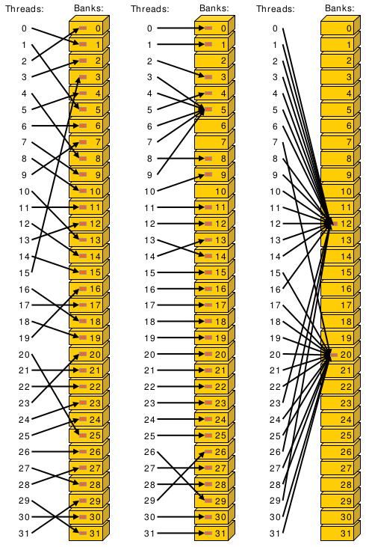
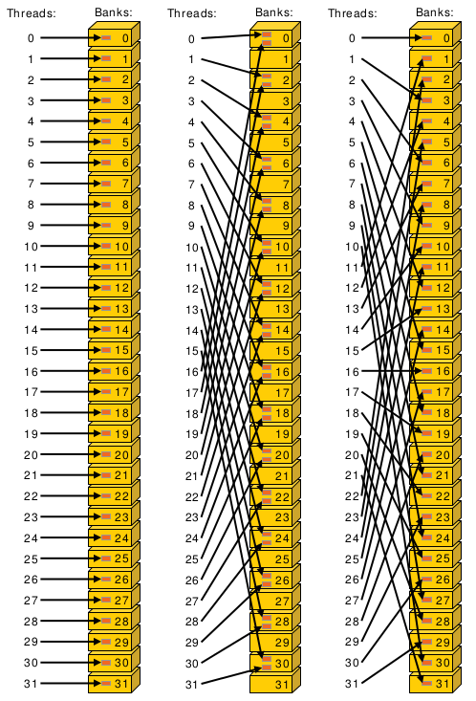
Bank conflict examples
Notes:
Center example would take roughly twice as long.
Bank conflicts might not seem like a huge deal (because access with 2-way bank conflict is same latency as arithmetic instruction) but can have significant effect on already partially tuned programs.

Slide 71
Bank conflicts and strides
Stride is the distance from thread i access to thread i + 1 access
Stride 1 ⇒ 32 x 1-way “bank conflicts” (so conflict-free)
Stride 2 ⇒ 16 x 2-way bank conflicts
Stride 3 ⇒ 32 x 1-way “bank conflicts” (so conflict-free)
Stride 4 ⇒ 8 x 4-way bank conflicts
…
Stride 32 ⇒ 1 x 32-way bank conflict :(
Notes:
Stride is distance from thread i access to thread i+1 access.
How many unique banks are accessed, and how many threads are accessing that bank

Slide 72
Padding to avoid bank conflicts
To fix the stride 32 case, we’ll waste a byte on padding and make the stride 33 :)
Don’t store any data in slots 32, 65, 98, ....
Now we have
thread 0 ⇒ index 0 (bank 0)
thread 1 ⇒ index 33 (bank 1)
thread i ⇒ index 33 * i (bank i)
Notes:
Note padding is wasting some very precious hardware, and also makes code uglier.

Slide 73
Registers
A Register is a piece of memory used directly by the processor
Fastest “memory” possible, about 10x faster than shared memory
There are tens of thousands of registers in each SM
Generally works out to a maximum of 32 or 64 32-bit registers per thread
Most stack variables declared in kernels are stored in registers
example: float x; (duh...)
Statically indexed arrays stored on the stack are sometimes put in registers
Notes:
Need to check assembly to see what is in registers.
Arrays must be statically indexed because instructions hard code register number.

Slide 74
Local Memory
Local memory is everything on the stack that can’t fit in registers
The scope of local memory is just the thread.
Local memory is stored in global memory
much slower than registers
Notes:
What’s the downside of storing local memory in global memory?
So how can we avoid storing anything in local memory?
Answer: use less local variables than registers
yes, but we’ve seen that using more local variables can help performance (assuming the local variables in registers)
sounds like we want to have as many variables that we can put in registers and no more!
If we have more local variables then registers, then some local variables will be spilled to local/global memory. This is called register spilling and kills performance.

Slide 75
Register spilling example
x0 = x[0];
y0 = y[0];
x1 = x[1];
y1 = y[1];
z0 = x0 + y0;
z1 = x1 + y1;
When we have enough registers, this code does 4 loads from local memory and 0 stores.
Now assume we only have 3 free registers before any of this code is executed (but don’t worry about z0 and z1)

Slide 76
Register spilling example
starting with only 3 free registers...
x0 = x[0];
y0 = y[0];
x1 = x[1];
y1 = y[1];
z0 = x0 + y0;
z1 = x1 + y1;
Register spilling cost:
1 extra load
1 extra store
2 extra pairs of consecutive
dependent instructions
cannot load y[1] until we free a register. store x1 to make space.
Now we need to load x1 again.
Notes:
Stores also have instruction dependencies (cannot use a register until the store from it is done).
The pairs of dependent instructions are the store x1, load y[1] (because we’re loading y1 into the same register that we’re storing from) and load x1, z1 = x1 + y1
There are worse spilling scenarios (what if x0 was stored?) and also better (just don’t load y1 until after computing z0), but its difficult for compiler to find optimal instruction ordering wrt spilling and dependencies.
A form of register allocation problem can be reduced to k-coloring a graph, which is NP-complete.
So, is register spilling (and any use of local memory) truly so bad for performance? Thankfully not (in small doses), due to the L1 cache.

Slide 77
Questions?
Global memory
Local memory
Shared memory
Registers
Notes:
Give brief explanation of each type of memory.
I’ll go over the most important types of memory first.

Slide 78
Part 2
L1/L2/L3 cache
Constant memory
Texture memory
read-only cache (CC 3.5)
Notes:
Give brief explanation of each type of memory.
I’ll go over the most important types of memory first.

Slide 79
L1 Cache
Fermi - caches local & global memory
Kepler, Maxwell - only caches local memory
same hardware as shared memory
Nvidia used to allow a configurable size (16, 32, 48KB), but dropped that in recent generations
each SM has its own L1 cache
Notes:
There are PTX instructions to load global memory to indicate whether you want to put it in L1 cache.
Recommendation: Use shared memory for whatever you can think of using it for, then make the rest of the space L1.
Makes local memory much cheaper (as register spills now go into L1 which is about as fast as shared).
so a little register spilling can be OK sometimes
L1 actually merged with texture cache in Maxwell.

Slide 80
L2 cache
caches all global & local memory accesses
~1MB in size
shared by all SM’s
Notes:
can look at L1/L2 hit/miss rates in profiler to see if local memory use is problematic

Slide 81
L3 Cache
Another level of cache above L2 cache
Slightly slower (increased latency) than L2 cache but also larger.

Slide 82
Constant Memory
Constant memory is global memory with a special cache
Used for constants that cannot be compiled into program
Constants must be set from host before running kernel.
~64KB for user, ~64KB for compiler
kernel arguments are passed through constant memory

Slide 83
Constant Cache
8KB cache on each SM specially designed to broadcast a single memory address to all threads in a warp (called static indexing)
Can also load any statically indexed data through constant cache using “load uniform” (LDU) instruction
Go to http://www.nvidia.com/object/sc10_cuda_tutorial.html for more details
Notes:
in this context, static does not mean known at compile time, it means all threads accessing the same same address.
Memory address cannot depend on threadId.
Cache is small/cheap because no writeback mechanism required.
Compiler uses LDU sometimes (const + pointer aliasing concerns)

Slide 84
Constant memory syntax
In global scope (outside of kernel, at top level of program):
__constant__ int foo[1024];
In host code:
cudaMemcpyToSymbol(foo, h_src, sizeof(int) * 1024);

Slide 85
Texture Memory
Complicated and only marginally useful for general purpose computation
Useful characteristics:
2D or 3D data locality for caching purposes through “CUDA arrays”. Goes into special texture cache.
fast interpolation on 1D, 2D, or 3D array
converting integers to “unitized” floating point numbers
Use cases:
Read input data through texture cache and CUDA array to take advantage of spatial caching. This is the most common use case.
Take advantage of numerical texture capabilities.
Interaction with OpenGL and general computer graphics
Notes:
for general purpose computing “texture support could not have been justified if the hardware hadn’t already been there” - cuda handbook
I’ve never used textures personally, and they are the most foreign part of CUDA to me.
CUDA arrays use trick like a space filling curve

Slide 86
Texture Memory
And that’s all we’re going to say on texture memory.
It’s a complex topic, you can learn everything you want to know about it from online resources.
Notes:
complex and not super useful in my opinion

Slide 87
Read-Only Cache (CC 3.5+)
Many CUDA programs don’t use textures, but we should take advantage of the texture cache hardware.
CC ≥ 3.5 makes it much easier to use texture cache.
Many const restrict variables will automatically load through texture cache (also called read-only cache).
Can also force loading through cache with __ldg intrinsic function
Differs from constant memory because doesn’t require static indexing

Slide 88
Questions?
Registers
Global memory
Local memory
Shared memory
L1/L2/L3 cache
Constant memory
Texture memory
Read-only cache (CC 3.5)
Notes:
Give brief explanation of each type of memory.
I’ll go over the most important types of memory first.

Slide 89
Next time....
Next lecture will be the last lecture focused on basic GPU knowledge
Few more optimization techniques
Synchronization
Will discuss GPU specific algorithms starting next week

Slide 90
CUDA applications (covered in CalTech course)
Solving PDEs on GPUs
GPU vs CPU fluid mechanics
Ray Traced Quaternion fractals and Julia Sets
Deep Learning and GPUs
Real-Time Signal Processing with GPUs

Slide 91
TDT4200 Fall 2024 Student Reference Group
Please contact for praise and suggestions on how we
can make this course better:
Ingar Asheim – ingara@stud.ntnu.no
Elin Skålund Berntsen – elinsbe@stud.ntnu.no
Hanne Marie Haakaas – hannamhaa@stud.ntnu.no
Suzanne Maduga – suzannm@stud.ntnu.no
Simone Deidier – simondei@stud.ntnu.no
Davide Esposito – davidees@stud.ntnu.no
Diego Velasco – diegove@stud.ntnu.no
???
???
Anne C. Elster – 2024

Slide 92

Parallel Computing is Fun!
Anne C. Elster – 2024

